Slide 1
CALIBRATION
&
UNCERTAINTY ANALYSES

Slide 2
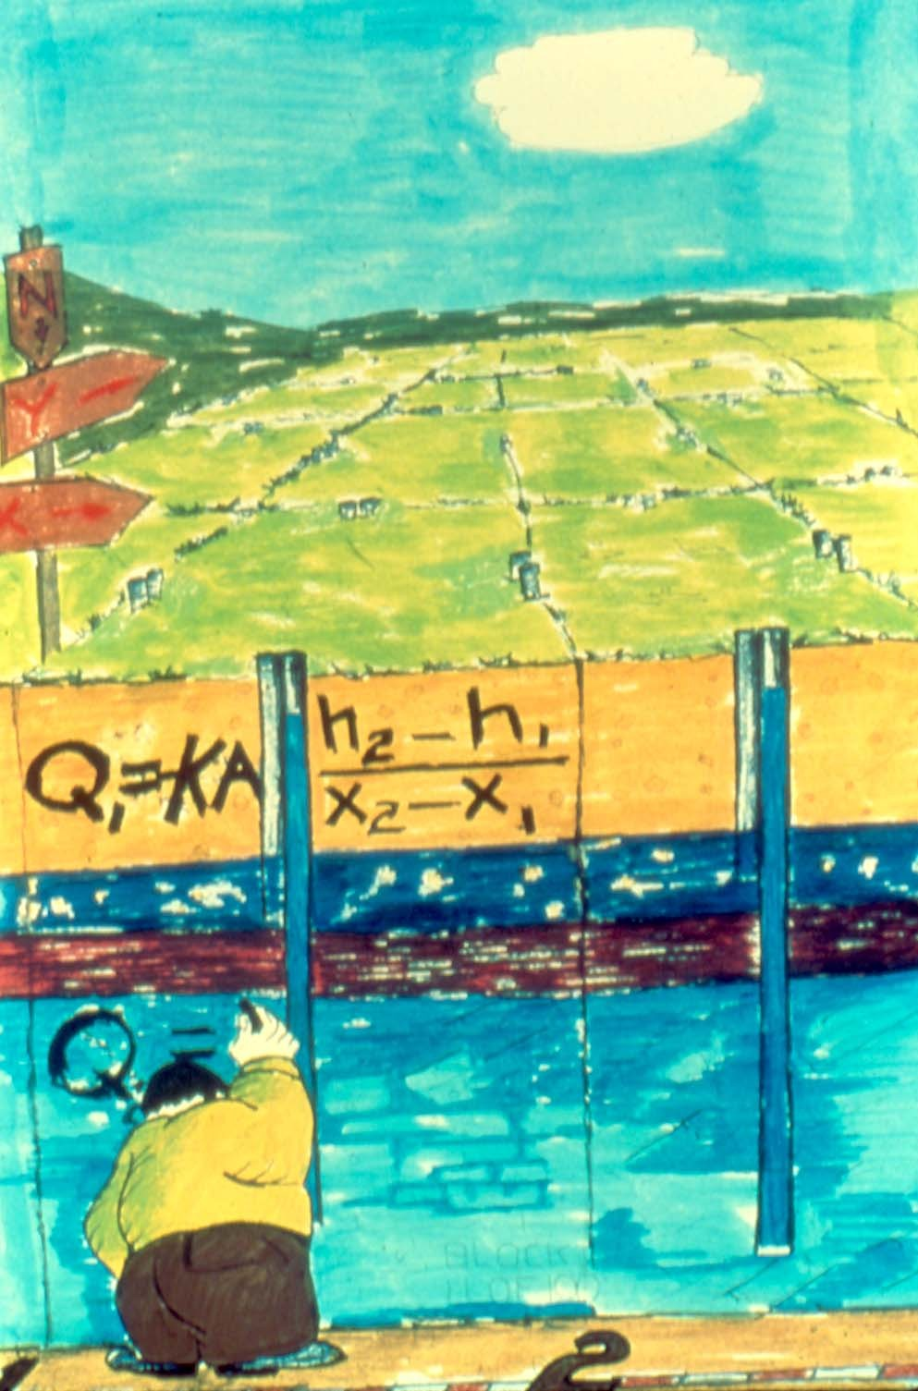
By Bennett
and Giusti

Slide 3
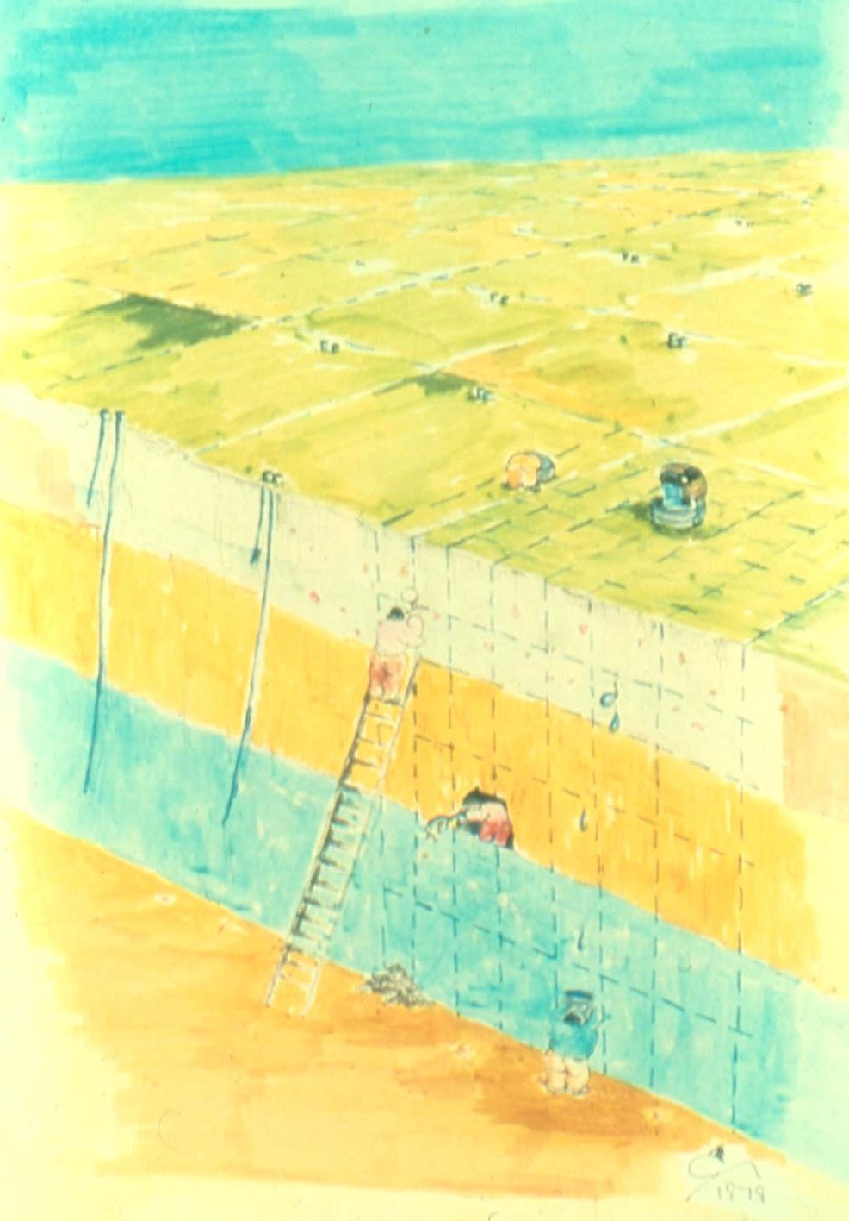
By Bennett
and Giusti

Slide 4
INPUT
OUTPUT
SYSTEM
STRESS
RESPONSE
b
×
A
➔
x

Slide 5
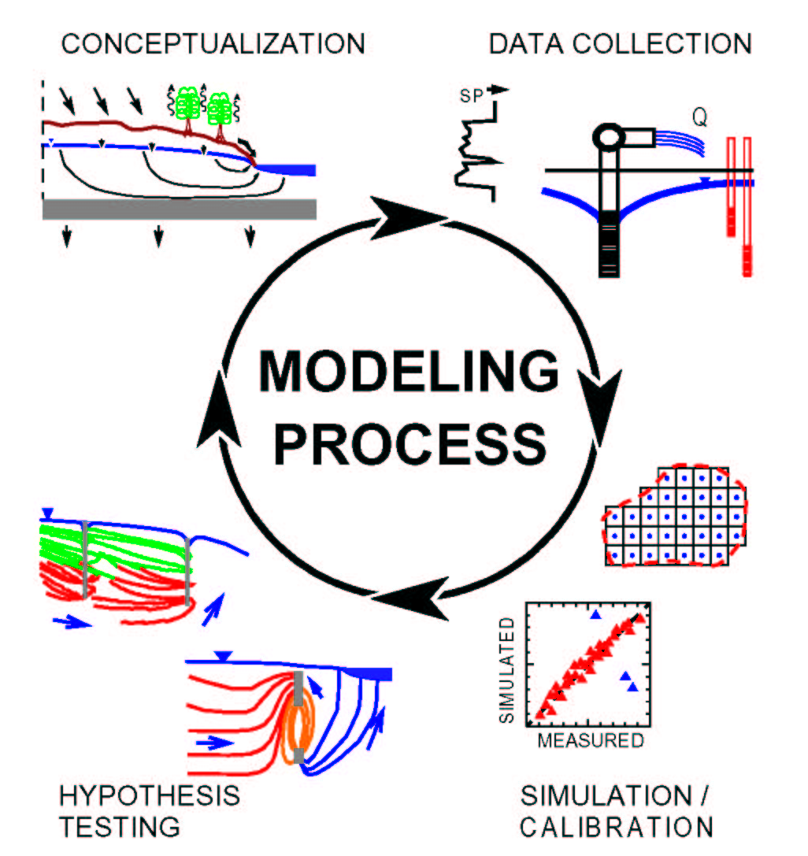
Halford, 1991

Slide 6
Types of Observations
Heads
Flows
Groundwater age
Concentration
Temperature
Others…

Slide 7
Residuals
Difference between a simulated value and its observed counterpart
For transient models, there may be many different measurements at the same location

Slide 8
Some measures of goodness of fit
The mean error
The mean absolute error
The root mean squared (RMS) error
The distribution of residuals
A qualitative comparison of the observed contoured head surface and the simulated contoured head surface

Slide 9
The mean error

Slide 10
The mean absolute error

Slide 11
The root mean squared error

Slide 12
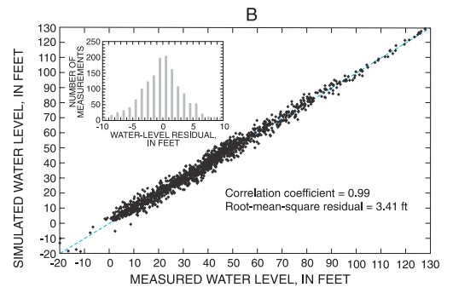
Residual Plot

Slide 13
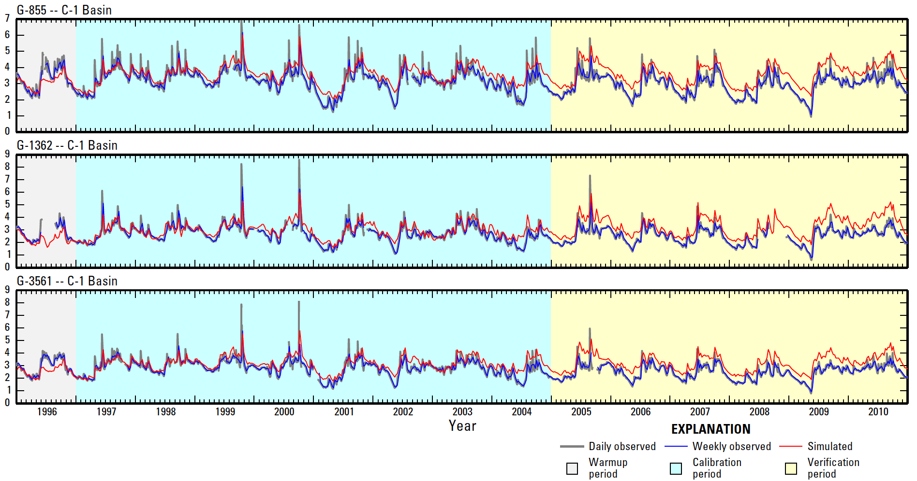
Residual Plot

Slide 14
The distribution of residuals
-
-
+
-
+
-
-
-
-
+
+
+
+
-
+
+
Random distribution (good)
Non-random distribution (not good)

Slide 15
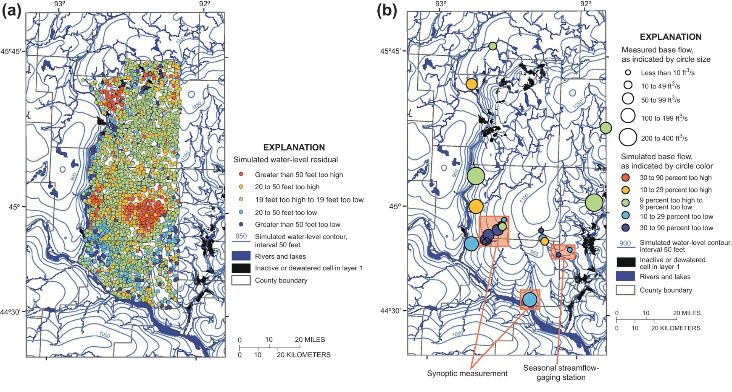
The distribution of residuals
Two examples of representing residual errors. (a) Similar size symbols with different colors can be effective when many data are shown, as is the case for head data from the large-scale groundwater model shown in the figure. With such a representation the spatial bias of simulated heads is effectively conveyed. (b) Different sizes and colors can be used when data are few, such as with flux targets in the same model domain as shown in (a).

Slide 16
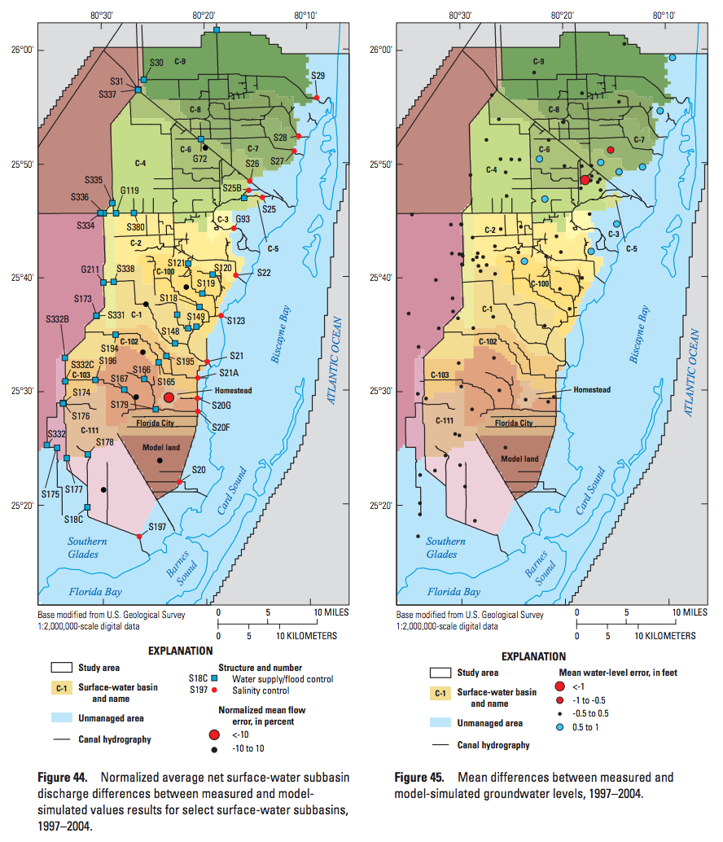
The distribution of residuals

Slide 17
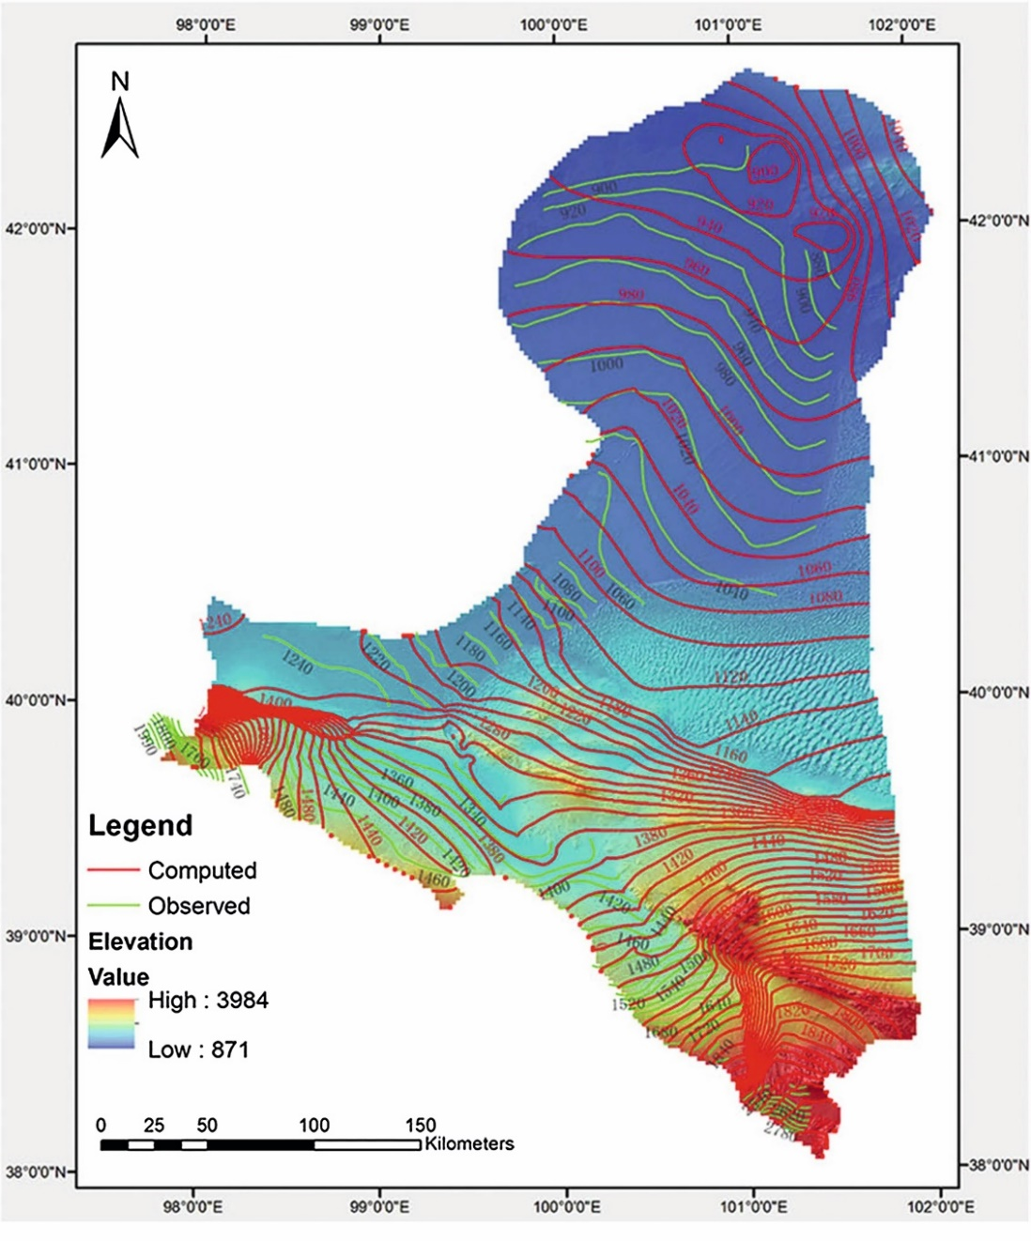
Comparison of head distribution
Map view of observed (green) and simulated (red) water table (shown by contours) in an arid inland river basin in China. Topographic elevations are shown by color shading (Yao et al., 2014).

Slide 18
Parameterization Approaches
Constant values
Zones
Pilot points
Fully distributed approaches (iterative ensemble smoother)

Slide 19
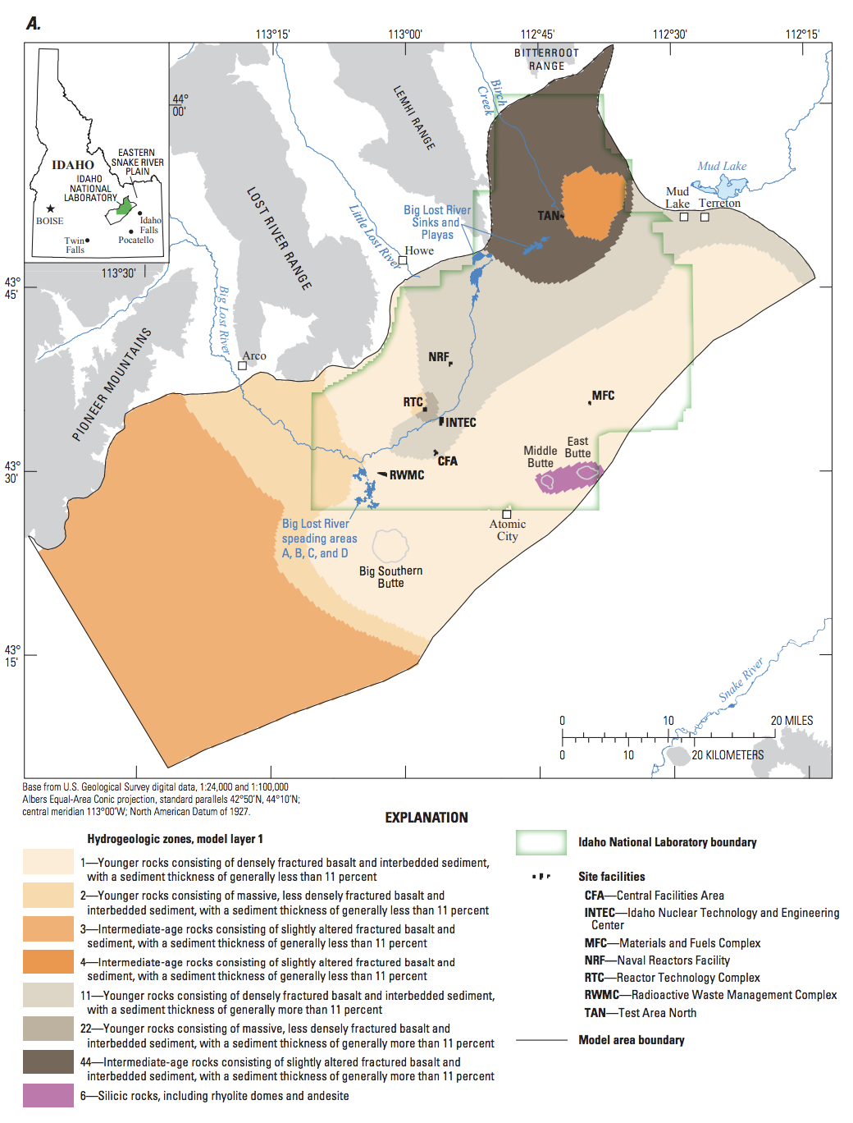
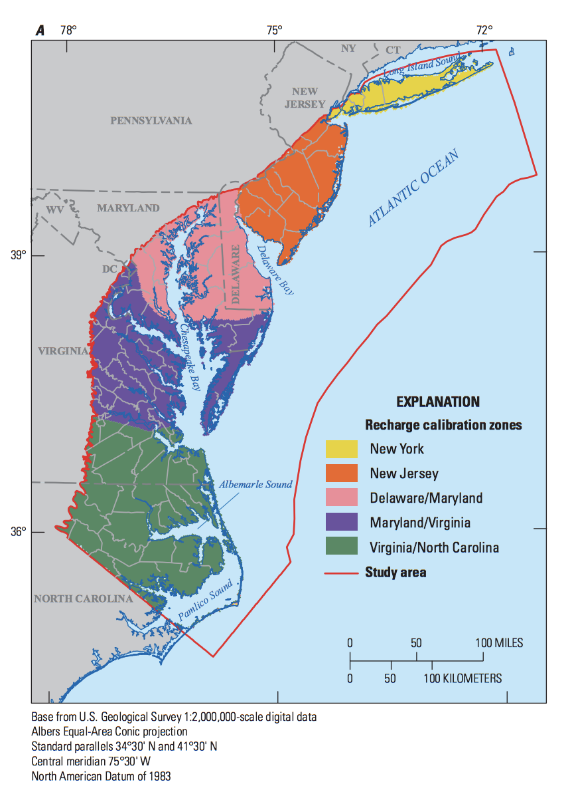
Zones

Slide 20
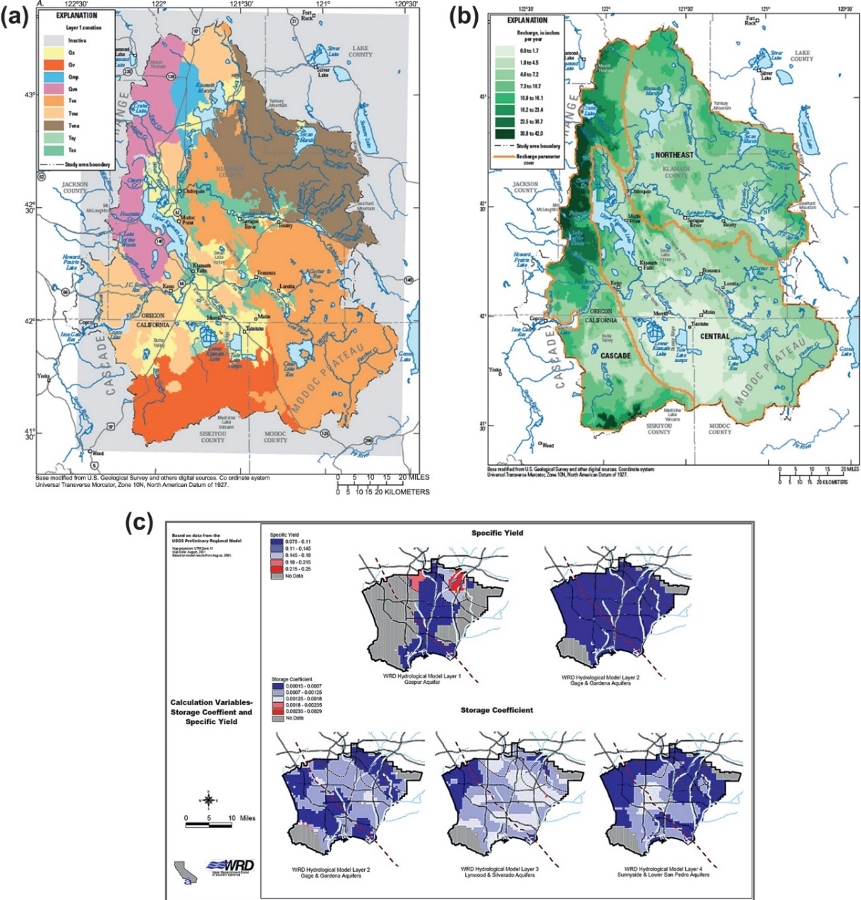
Zones
Examples of parameter zonation: (a) hydraulic conductivity zones (Gannett et al., 2012); (b) recharge zones (Gannett et al., 2012); (c) storage parameters (Johnson and Njuguna, 2002).

Slide 21
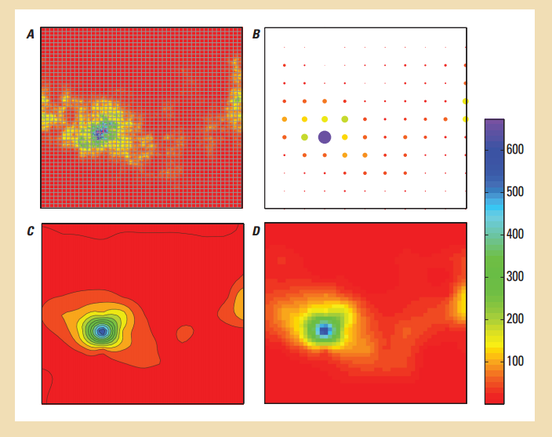
Pilot Points

Slide 22
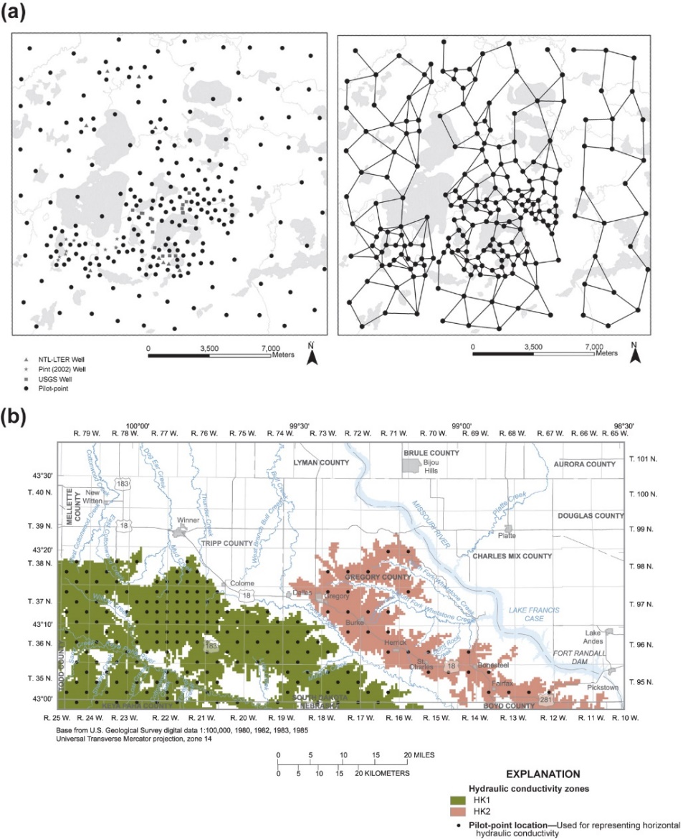
Pilot Points
(a) Network of pilot points in a watershed-scale groundwater flow model (left); linkages between pilot points (right) used to calculate Tikhonov regularization constraints for preferred homogeneity (modified from Muffels, 2008). (b) Network of pilot points used to represent two hydraulic conductivity zones where Tikhonov regularization is applied to pilot points within the same zone (modified from Davis and Putnam, 2013).

Slide 23
Calibration Approaches
Trial and error
Automated parameter estimation

Slide 24
Trial and Error
Use sensitivity analysis to identify important parameters
Manual adjustment of parameters within reasonable limits in order to improve match between observed and simulated values

Slide 25
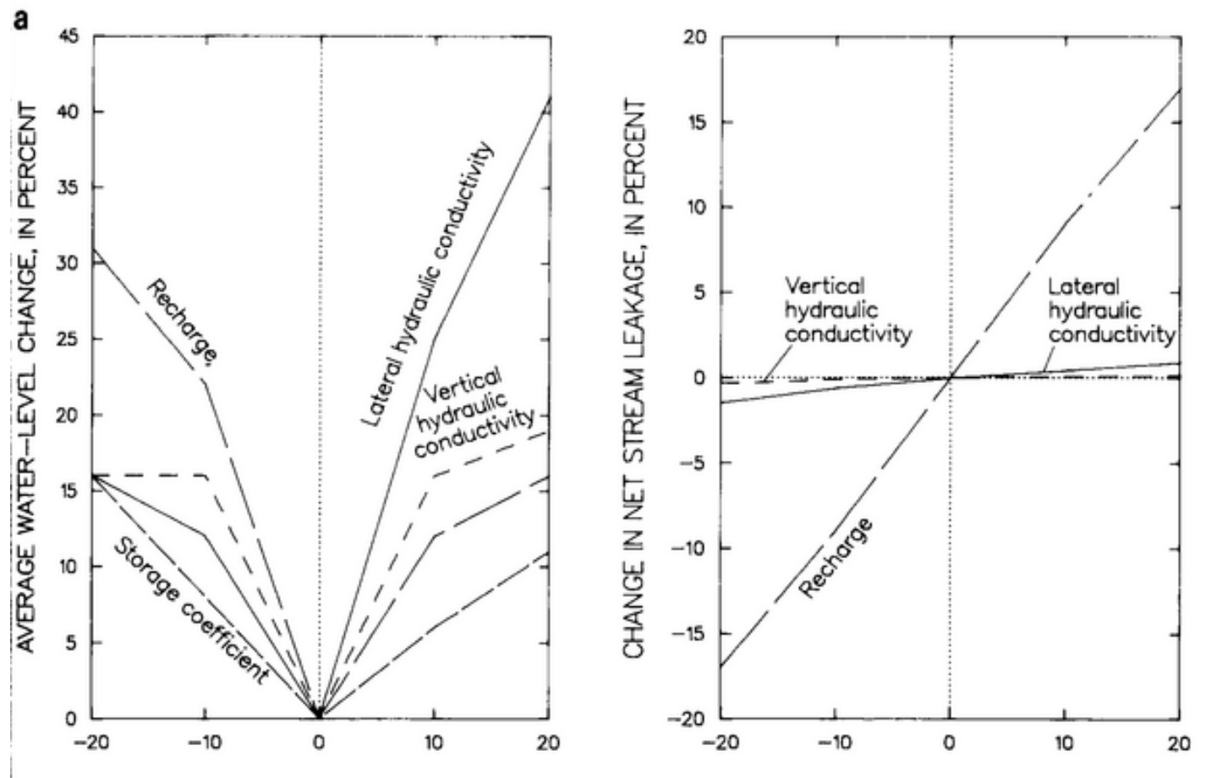
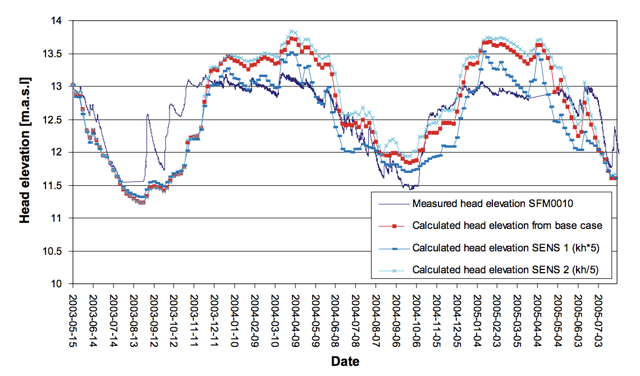
Sensitivity Analyses
Anderson and Woessner, 1992

Slide 26
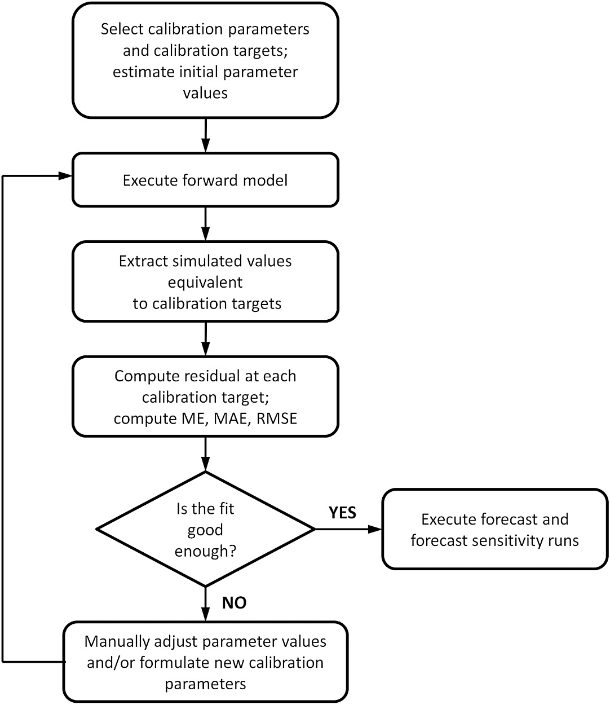
Trial and Error
General workflow for manual trial and error, the first phase of history matching a model intended for forecasting (ME, mean error; MAE, mean absolute error; RMSE, root mean squared error).

Slide 27
Automated Parameter Estimation
Two different categories
Overdetermined: more observations than parameters
Underdetermined (highly parameterized): may have more parameters than observations. Requires additional information.
Neither are really automated!

Slide 28
Concept
HEAD
HYDRAULIC CONDUCTIVITY

Slide 29
What about many parameters and many observations?
NOBS
NPAR

Slide 30
Sum of Squared Weighted Residuals

Slide 31
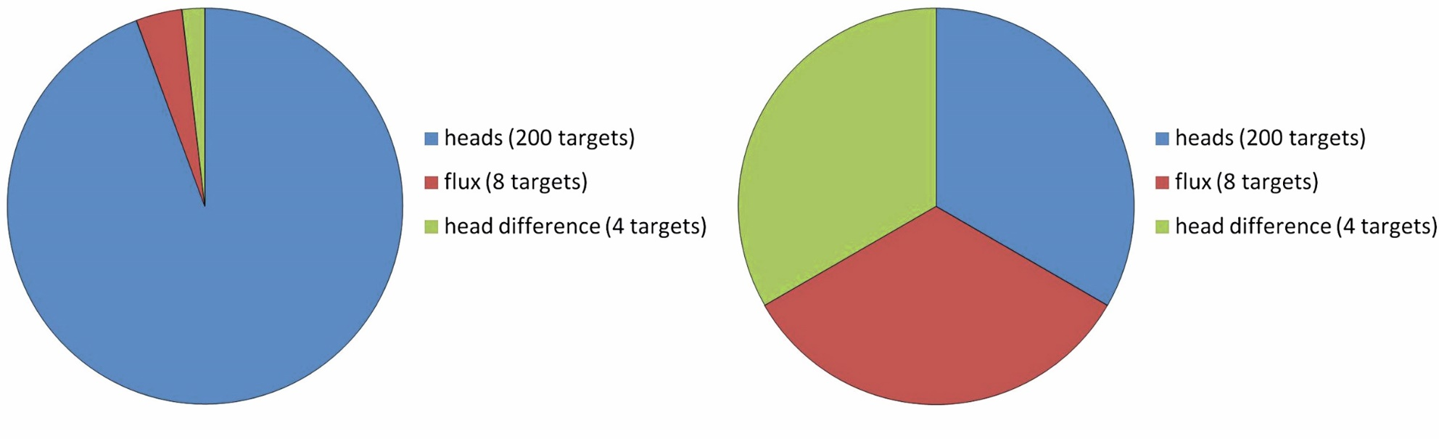
Sum of Squared Weighted Residuals
Pie charts of an initial objective function that is: (a) unbalanced because the number of head targets is much larger than other targets and (b) more balanced because no one target type dominates or is dominated by other groups. The more balanced objective function was obtained by simply normalizing the observation weights by the number of targets in each group.

Slide 32
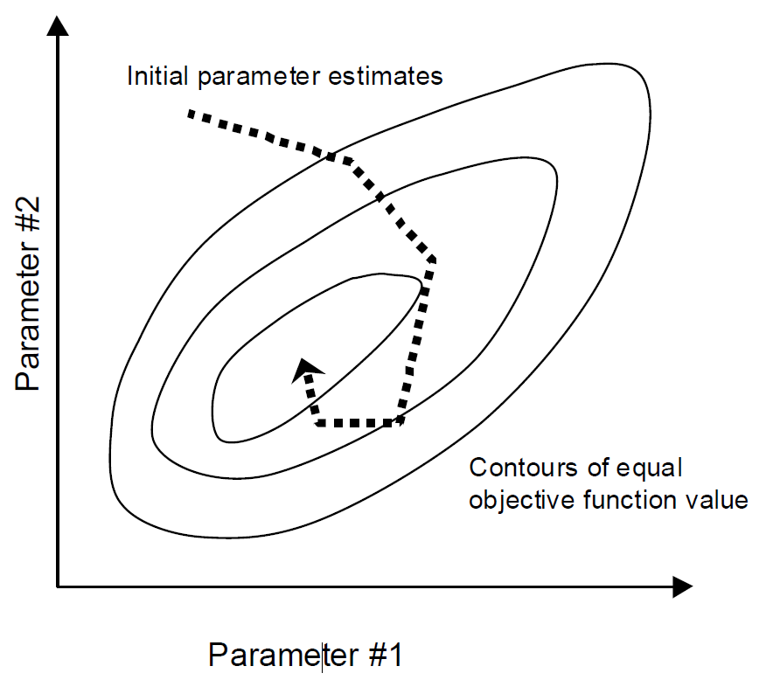
Nonlinear Parameter Estimation

Slide 33
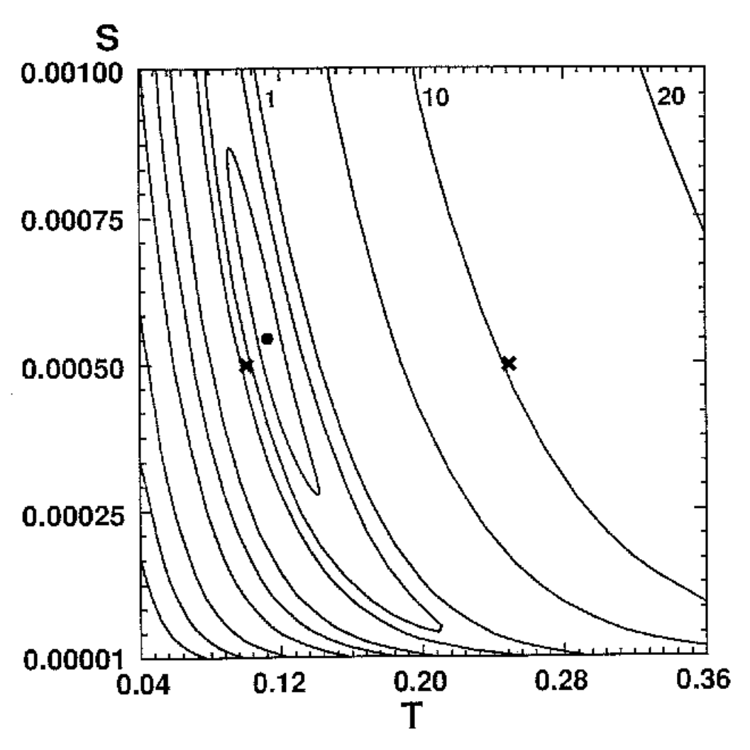
Objective Function Surface

Slide 34
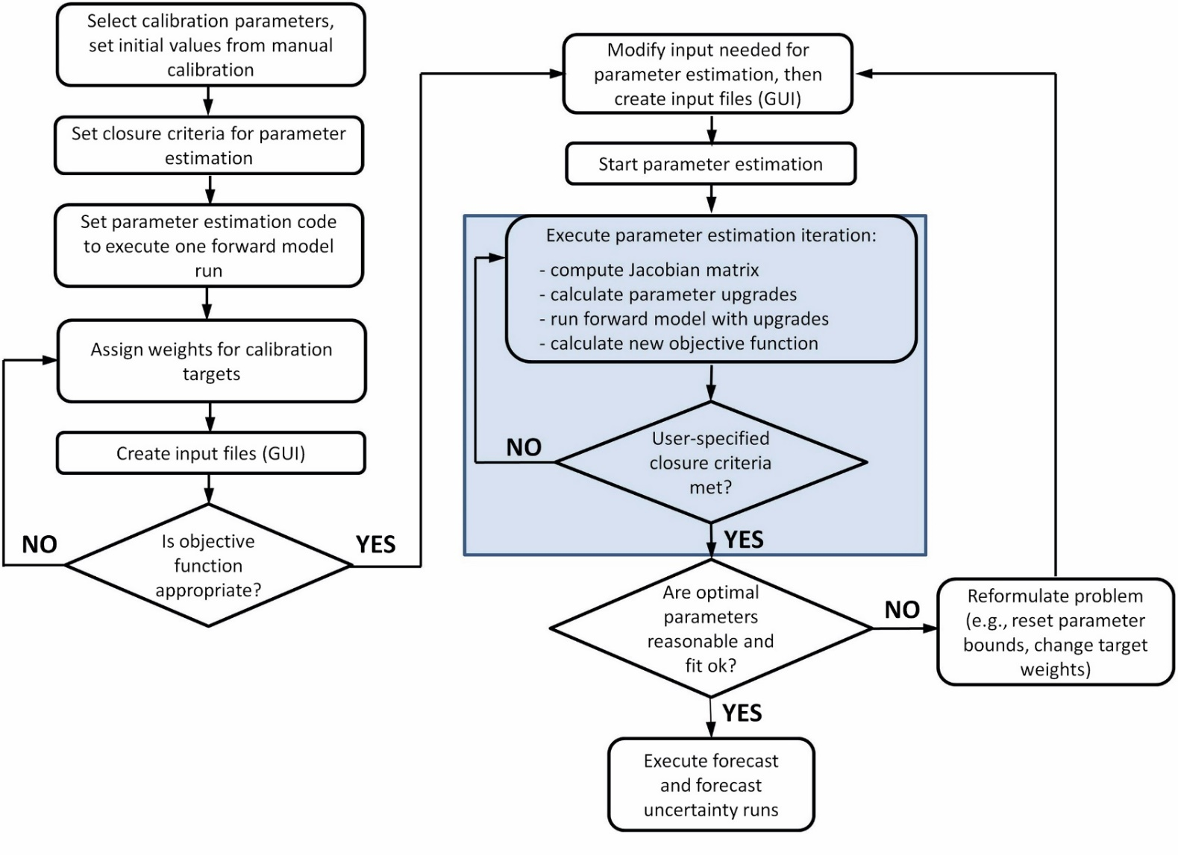
Parameter Estimation Procedure

Slide 35
Concepts To Keep In Mind
Compare heads, flows, concentrations
Continuously re-evaluate system conceptualization – boundary conditions, framework, etc.
Try to understand the sensitivity of the system to different parameters and boundaries
We are trying to make a simplified mathematical copy of the real world

Slide 36
Calibration is but one part of our attempt to understand and duplicate the actual system in a numerical model.
WARNING
“… a model involving a wrong or incomplete conceptual model can be adequately calibrated.”
J.D. Bredehoeft (2003, Ground Water, vol. 41, no. 5)

Slide 37
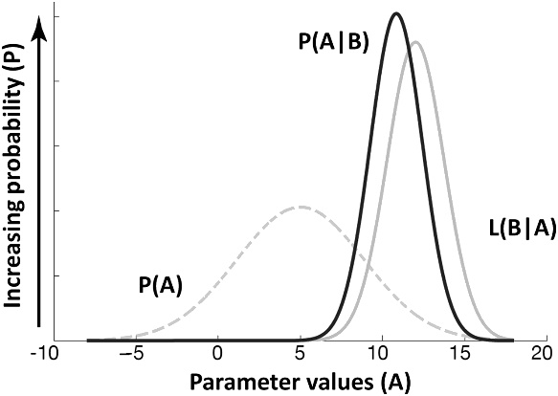
Uncertainty Analyses

Slide 38
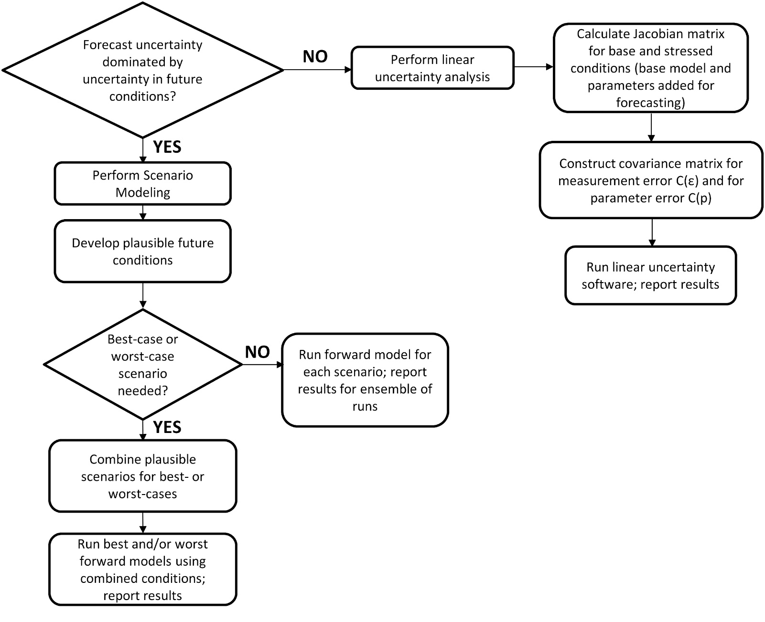
Uncertainty Analyses
Schematic diagram of a potential workflow for performing basic uncertainty analysis.

Slide 39
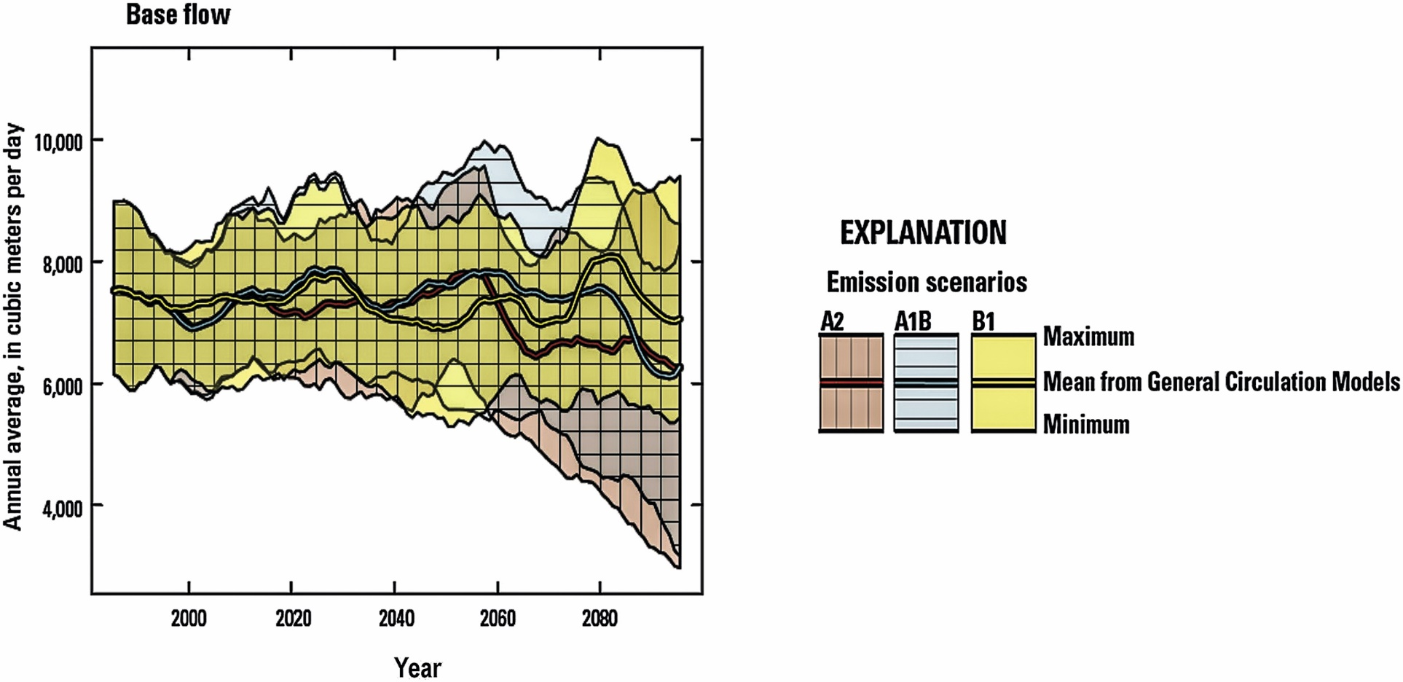
Uncertainty Analyses
A forecast of baseflow summarizing 15 scenario forward runs (maximum, minimum, and average conditions in each of three emission scenarios). Forecast uncertainty is shown by the envelope around the means of the three scenarios (colored lines). The forecasts derived from the mean of each emission scenario were based on the mean results from 5 different General Circulation Models. Note how the uncertainty envelope increases with time (Hunt et al., 2013).

Slide 40
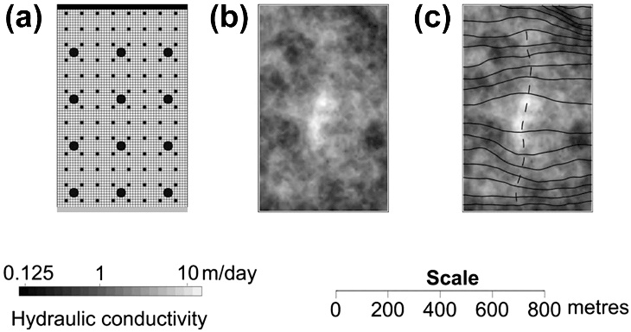
Uncertainty Analyses
Details of the synthetic aquifer: (a) model domain and grid with the 12 head observation locations (representing wells) shown as large circles and pilot point locations shown as small circles. (b) The “true” hydraulic conductivity field. (c) Head contours (solid lines) and particle track (dotted line) calculated for the true hydraulic conductivity field (modified from Moore and Doherty, 2005; Moore et al., 2010).

Slide 41
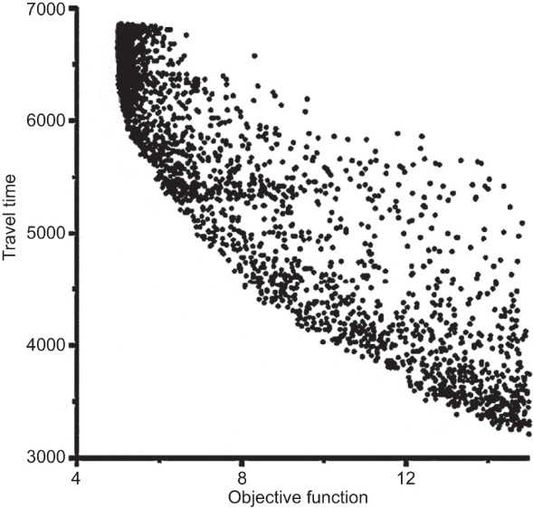
Uncertainty Analyses
A Pareto front diagram showing a forecast of particle travel time in days (vertical axis) versus the calibration objective function (horizontal axis). Each dot represents a forecast made with a different calibrated model. Well-calibrated models have low objective functions and poorly calibrated models have relatively higher objective functions. The true travel time through the synthetic aquifer (Fig. B10.2.1) is 3256 days, which is only sampled when the objective function is at its upper limit of feasibility (modified from Moore et al., 2010).

Slide 42
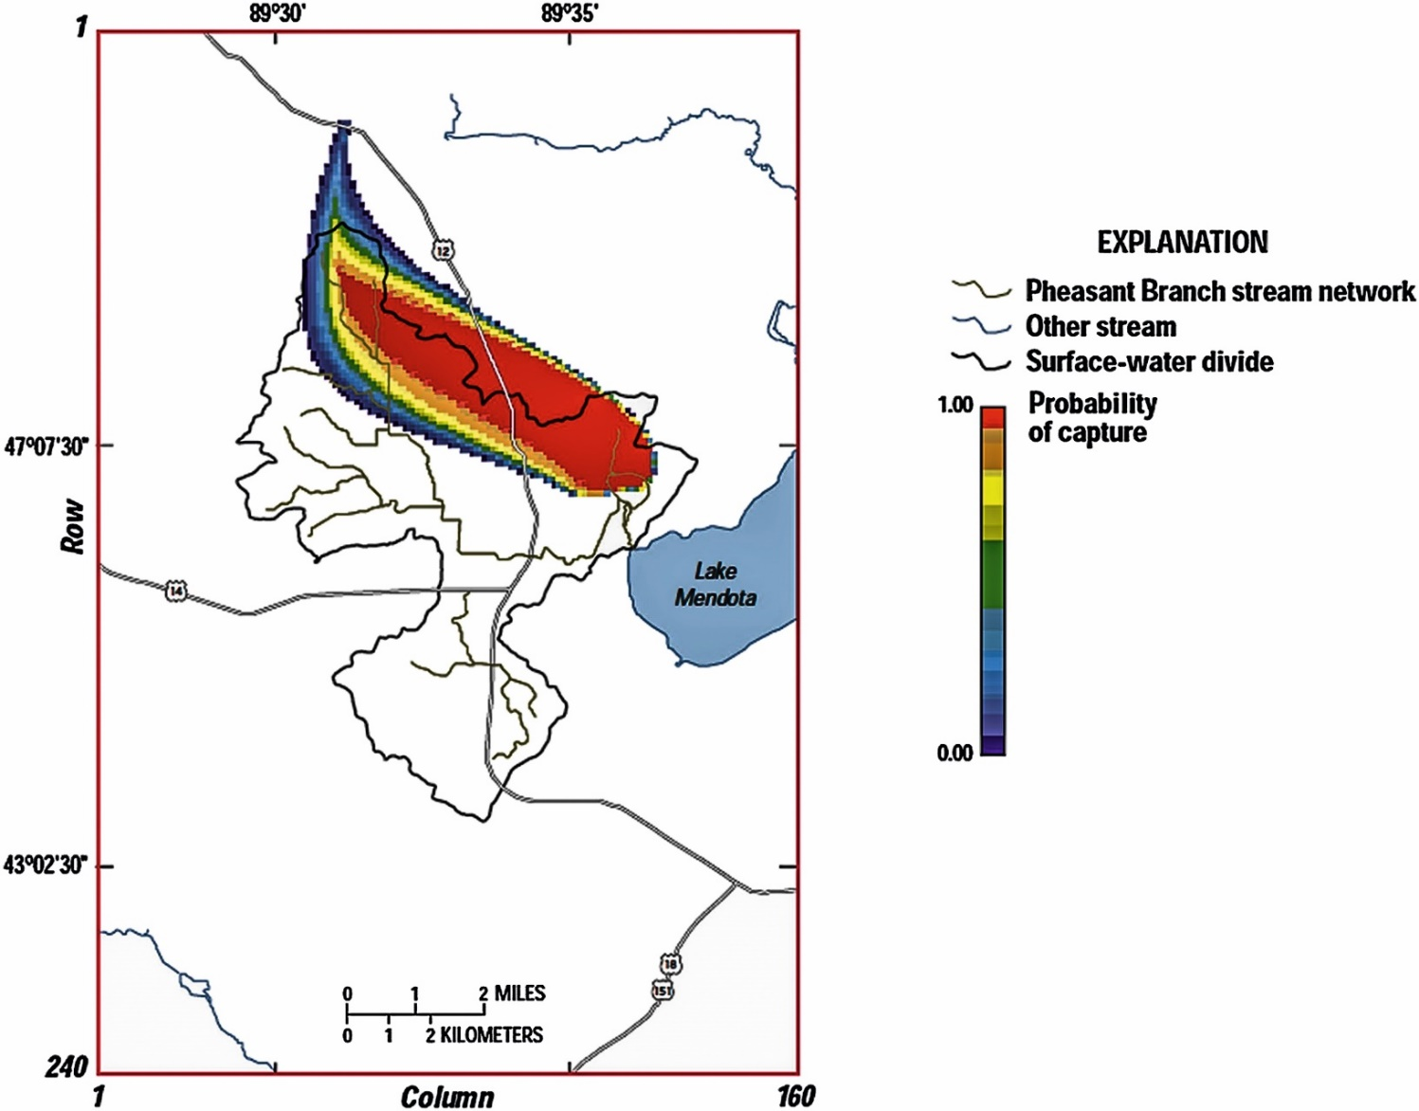
Uncertainty Analyses
Visualizing uncertainty as a probabilistic area of contribution for a spring complex. The graphic is based on 136 conditional simulations and shows low (blue) to high (red) probability for the extent of the area of contribution (modified from Hunt et al., 2001).

Slide 43
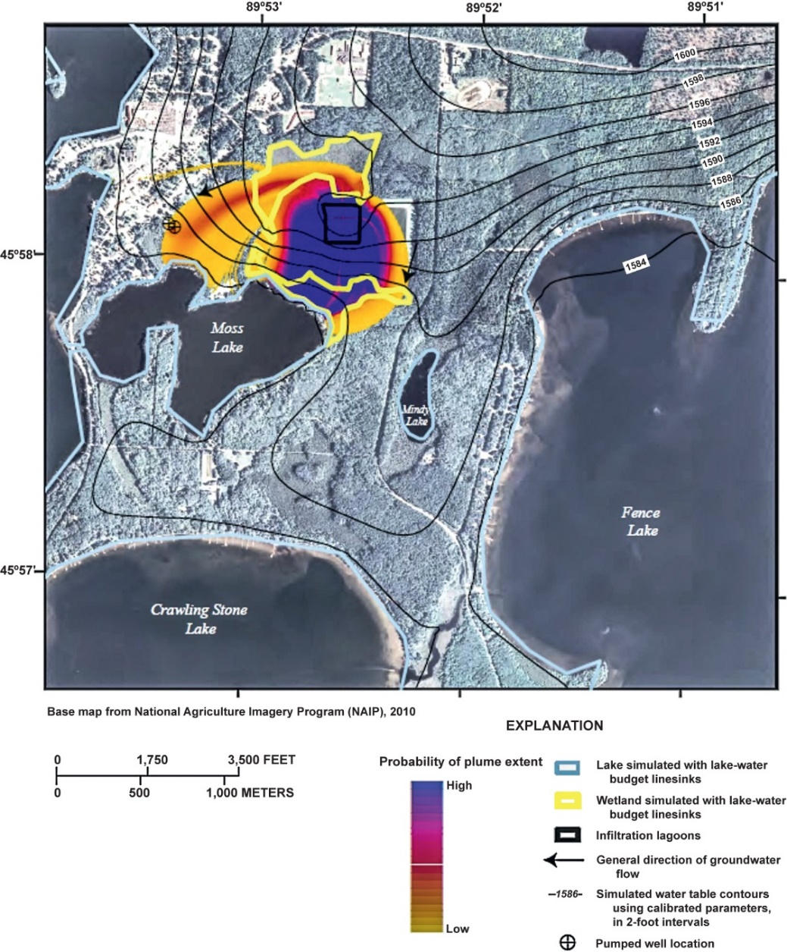
Uncertainty Analyses
Simulated probability due to uncertainty in advective transport parameters affecting a plume emanating from treatment lagoons. Blue color represents high probability flowpaths; orange colors represent low probability flowpaths (Juckem et al., 2014).

Slide 44
Major Components Of A Groundwater Model Report
A description of the natural system.
A description of the numerical counterpart with the model input fully documented.
A convincing argument that the numerical model is a plausible representation of the natural system.

